Slide 1


GloBox: A Case Study
A/B Test on launch of a new banner

Slide 2
About the company
E-commerce company
2 segments: boutique fashion items and high-end decor products and food & drinks
Key stakeholders:
Mei Kim, Head of Marketing
Leila Al-Farsi, Product Manager, Growth
Growth Product & Engineering Team
Alejandro Gonzalez, User Experience Designer, Growth

Slide 3
Question asked by the company
Will introducing a new banner at top of the website with highlighted food & drinks, increase conversion rate and as a result revenue?

Slide 4
Experiment to answer the question asked….
A/B Testing
Hypothesis Test includes:
Null Hypothesis: conversion rate is not dependent on showing the banner at the top of the website
Alternate Hypothesis: The conversion rate is directly dependent on showing the banner on the website
Significance Level (α)
2 sample groups:
Control Group or Group A: existing landing page without banner
Treatment Group or Group B: landing page after the launch of the banner
α = 0.05

Slide 5
Experiment Continued….
No. of users in A: 24343
No. of users in B: 24600
Conversion Rate of Groups A & B
Probability of rejecting or accepting the Null Hypothesis
RESULT:
p-value < α, Null Hypothesis REJECTED.

Slide 6
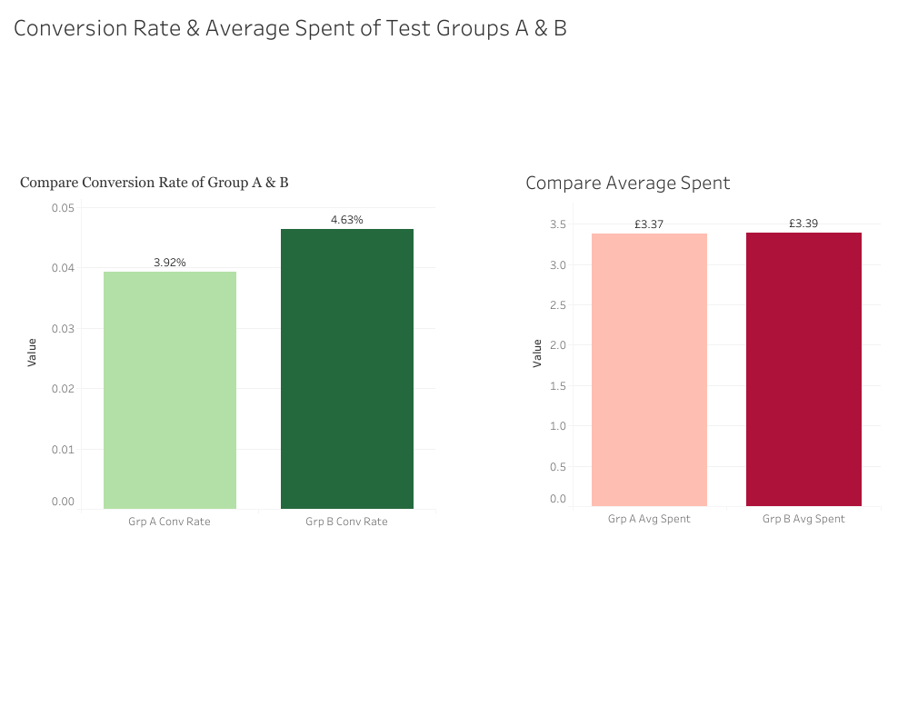
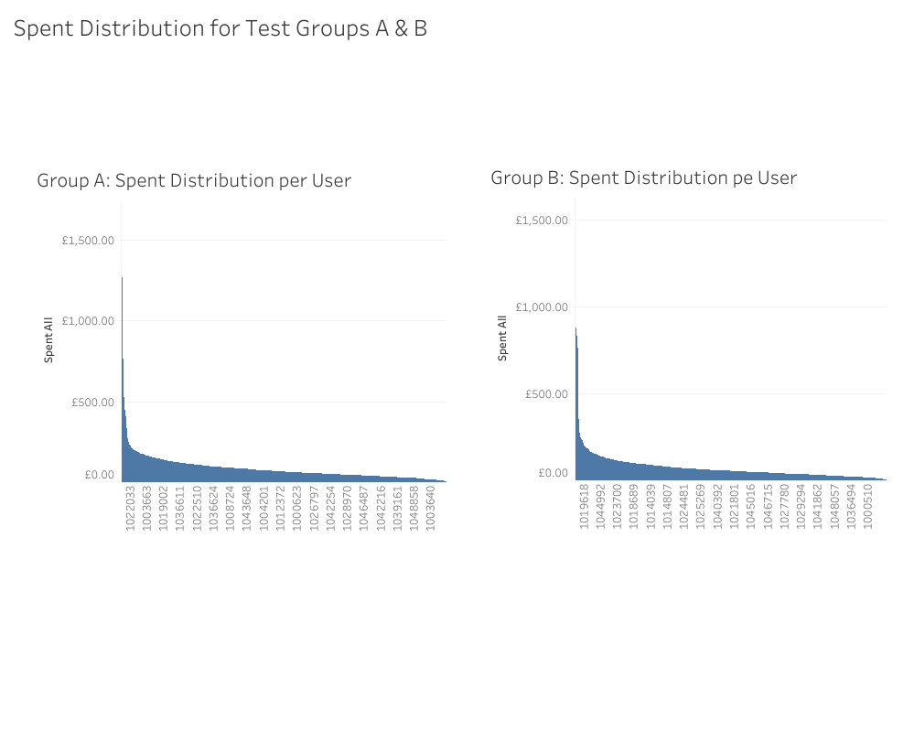
Analysis….

Slide 7
Analysis Continued….
conversion rate of Treatment Group > Control Group
average spent of both groups are almost same

Slide 8
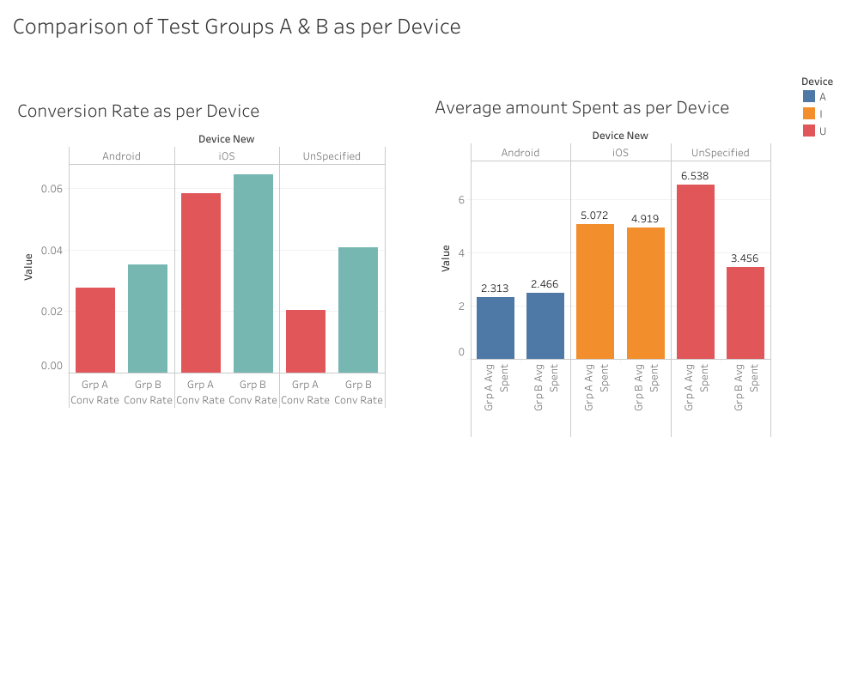
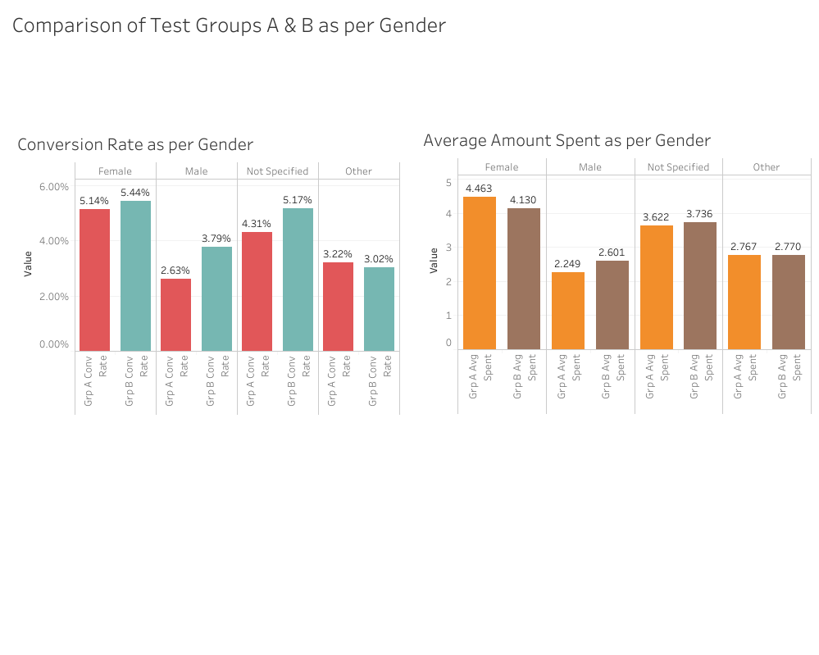
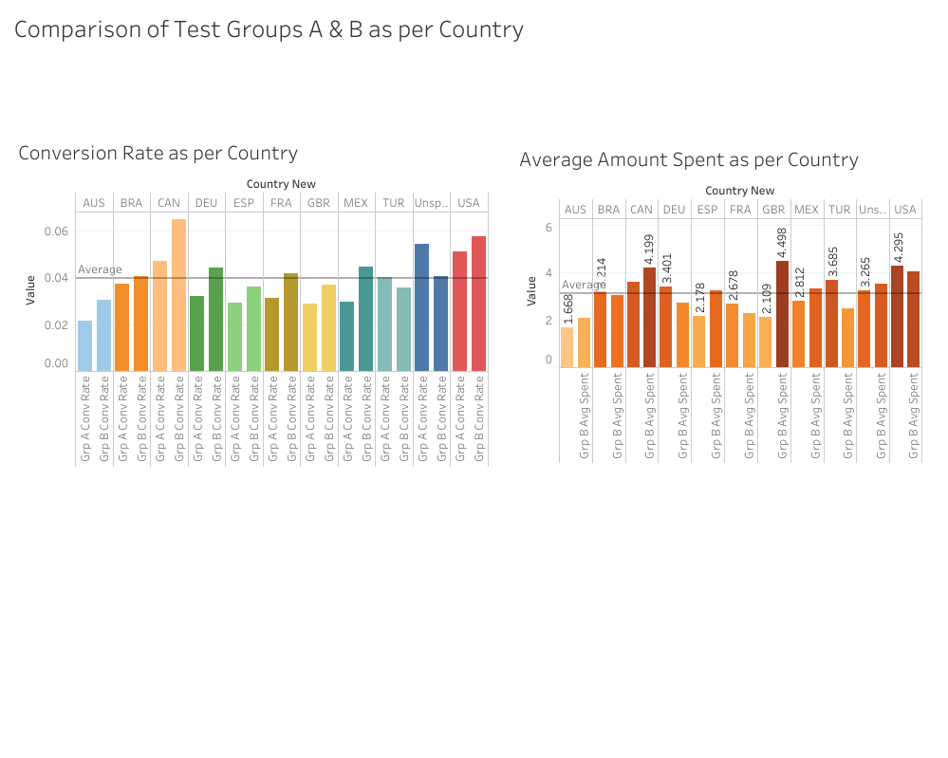
Analysis Continued….

Slide 9
Analysis Continued…
Unspecified device segment has less conversion rate < iOS, but spent amount is highest
Female segment conversion rate & spent amount both high
North American countries have higher conversion rate as compared to others.

Slide 10
Recommendations
Launch of banner for next 3 months and reconsideration to continue at the end of quarter
Scope high with Unspecified device segment. More research to be done on them.
Marketing strategy to attract male, unspecifies & others in the gender segment.

Slide 11
Thank You

